Slide 1
Sisterhood News – July 2024
You don’t have to be a Sisterhood member to participate in any Sisterhood program. But it helps. Please join us.
Our Next P.A.D. Party
SAVE THE DATE:
Sunday, August 4, 2024, 11am
Have fun. Do a good deed.
Just give us an hour of your time.
Join us as we assemble monthly kits for some of the neediest of our community.
Please consider donating Individually wrapped feminine hygiene products to include in these kits. They are being collected now, in the barrel outside the Chapel.
Or, send a donation, and we will purchase items for you. Send your donation to
TBE Sisterhood, 139 Winton Rd South, Rochester NY 14610. Write “PAD Donation” in the memo.
Thank you for your kind generosity.
Happy Summer
2024-2025
Sisterhood
Calendar Highlights
Aug 4, 2024, 11 am – PAD Party
Oct 2024 - Torah Fund Event
Dec 2024 - Chanukah Party
Jan 18, 2025 - Sisterhood Shabbat
Feb 2025 - Tu B'Shevat Seder
Mar 2025 - PAD Party
June 2025 - Sisterhood Annual Mtg
Aug 2025 - PAD Party
Have you paid your Sisterhood Dues Yet?
PLEASE JOIN TODAY!
Your membership is important!
Sisterhood organizes our many programs, which are enjoyed by the entire Temple family. We rely on your dues to fund these activities. The more paid members we have, the more we can accomplish.
Please mail your
- Name, - Email,
- Address, - Phone number,
along with $36 dues (July 2024-July 2025) to Temple Beth El Sisterhood,
139 Winton Road South, Rochester, NY 14610.
Sisterhood Shabbat
January 18, 2025
Celebrate
Sisterhood’s 105th anniversary
Please join us. Enjoy the service and kiddush.
This service honors and highlights women of our congregation. It provides an opportunity for women to practice their skills, have new opportunities, and learn new skills.
We want to honor you. Will you take part in our service? There are many opportunities for every skill level. Contact Gail at gailfink49@gmail.com.
Our hearts go out to the families and friends of those killed, wounded and kidnapped. We hope and pray that this war will end with a positive outcome for the State of Israel, its people, and Jews worldwide.
Notes:
oches

Slide 2
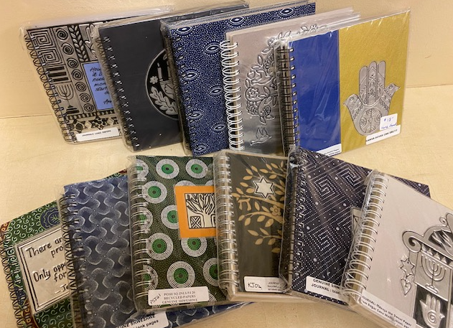
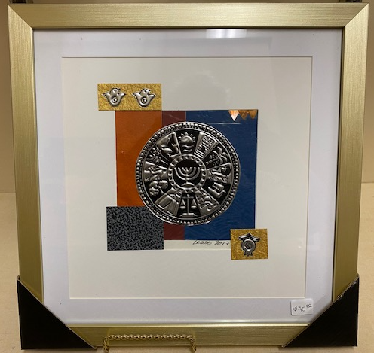
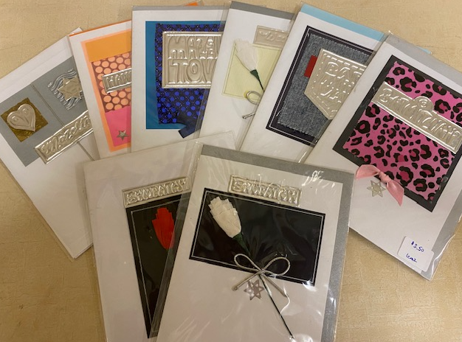
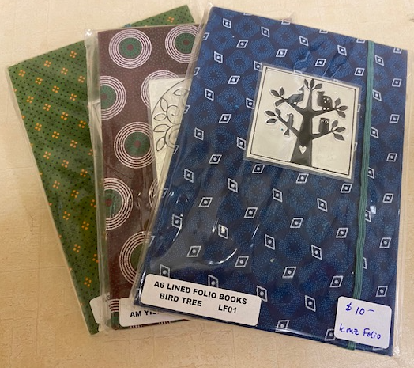
More Sisterhood News – July 2024
TBE Sisterhood membership dues include your membership in Women’s League for Conservative Judaism (WL). WL membership opens the door to a world of additional programming, leadership development, and much more. Learn about WL at wlcj.org.
Contact Gail Finkelstein for your WL member number.
Just Judaica Gift Shop
the largest Judaica Shop in Central & Western New York
NEW HOURS
Wednesdays 3:00-5:30 pm
Summer Sundays by appointment only
New merchandise received every week.
“Window shop” the displays near the entrance and the Gift Shop window.
Stop by often.
Call for an appointment:
Iris 585-739-2428
Lynda 585-385-3563
Gail 585-755-8790
This month we focus on ICONZ unique metal embossed art, handmade in Cape Town, South Africa. We have just obtained a new supply of wall art, notebooks and cards.
Each piece is individually made using locally sourced aluminum, fabrics, papers and beads. ICONZ designs are visualized by artist Leslie. They support their community by only employing local labor, creating work for previously unemployed women. Their team handcrafts each design, giving each piece an authentic, special handmade effect.
Notes:
Wlt

Slide 3
More Sisterhood News – July 2024
Yiddish Words of Summer: Embracing the Heat and Joy
May your summer season be filled with shvitz-free days and endless nachas.
As July unfolds in Rochester, the city's energy quickens with the sweltering sun, and it's not just the temperature rising; it's the Yiddish words that come alive with the season. From shvitzing in the summer heat to leisurely shpatziring through the streets, Yiddish enriches our experience of this vibrant time of year.
Shvitz - The word itself conjures up the sensation of sweating profusely in the heat. Originally meaning a steam bath, the shvitz has deep roots in Jewish culture, tracing back to ancient times when bathhouses were integral to communal life. It found a new home in New York’s bustling Lower East Side, where it became a place not just to cleanse the body but to unwind and connect with others amidst the steam.
Shpatzir - To shpatzir is to wander aimlessly, to stroll without a destination. Unlike "schlep," which implies a burdensome journey, or "patshke," meaning to waste time, shpatziring is about the pleasure of the journey itself. It's a leisurely pace, a chance to let the day unfold naturally and enjoy the simple pleasures of summer.
Mechaiyeh - Derived from the Hebrew word for life, "chai," mechaiyeh encapsulates those moments that make us feel truly alive. Whether it's dancing to music, sharing a moment with loved ones, or soaking in the warmth of a summer afternoon at the beach, these experiences rejuvenate the spirit and remind us of the joy of living.
Nachas - A uniquely heartwarming emotion, nachas is the pride and joy felt for others' accomplishments or the happiness derived from their successes. It's a deep sense of fulfillment that nourishes the soul, much like mechaiyeh enhances life itself.
Additional Yiddish Summer Vocabulary:
Der Zumer - Summer
S'iz Heys - It's hot
S'iz Dushne - It's humid
Di Zumer Shpreklekh - Freckles (literally, "summer freckles")
Di Zumer Feygele - Butterfly (literally, "summer bird")
Yiddish Proverbs for the Season:
Vos es geyt avek vinter af heytsung geyt avek zumer af narishkeytn - What you spend in the winter on heat, you spend in the summer on folly.
Heys vi in bod af der eyershter bank - It's as hot as a bathhouse when sitting on the top bench.
Men ken tsegangen vern - You could melt!
As we navigate the heat and joys of summer, may you find delight in shpatziring through the streets, experiencing mechaiyeh in the little moments, and savoring nachas in the successes of others. Let these Yiddish words and sentiments infuse your summer with warmth, laughter, and a sense of community that transcends generations. Enjoy the season, and may it be filled with shvitz-free days and endless nachas!
Credit blog at Beames Designs! Glass. Our Gift Shop carried Beames items like wedding “smash” glasses and yahrzeit candle holders.

